Slide 1
FLIGHT BOOKING PREDICTION
SABARINATH MURALIDHARAN SUJATHA
21 November 2022

Slide 2
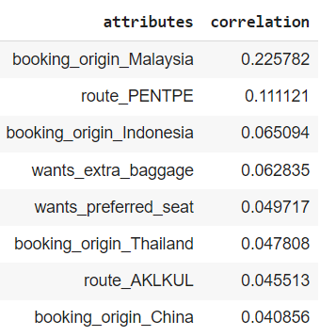
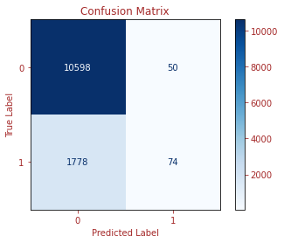
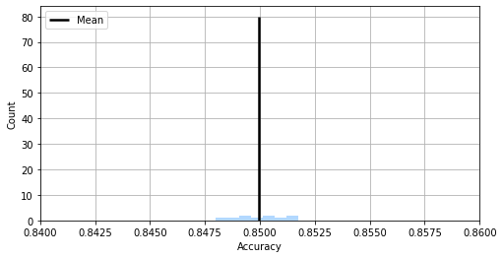
PREDICTIVE MODELLING
The false positive is very low compared to the false negative so even if the model predicts that the ticket booking will not be completed, there are high chances of the customer booking the tickets for the flight
Customers from Malaysia, Indonesia, Thailand and China have a high chance of completing the booking
PENTPE route has the highest confirmation rate followed by AKLKUL route
Chances of increase in booking if there is seat preference and extra baggage allowance
We are 95% confidence that the accuracy of the prediction would be between 84.75% to 85.25%. Therefore the margin of error is only 5%

